Slide 1

Honeypot phishing campaign
Analyzing Phishing Behavior and Enhancing Security Monitoring
By group 2

Slide 2
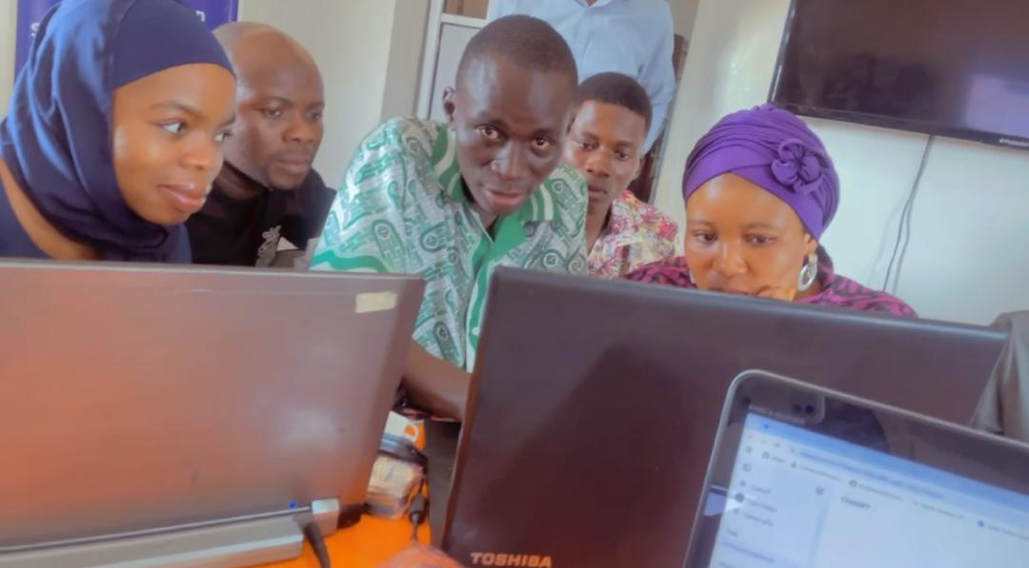
Team members
Ahmed Olakunle Mustapha—FE/23/78296064
Akinde Gideon Toluwani—FE/23/68945453
Aremu Ayodeji Seun—FE/23/99247117
Adelekan Kafayat Aderonke—FE/23/10128217
Mahmud Nafisa Gidangoga—FE/23/7236016
Onilude Hammed Ayanniyi—FE/23/81119378

Slide 3
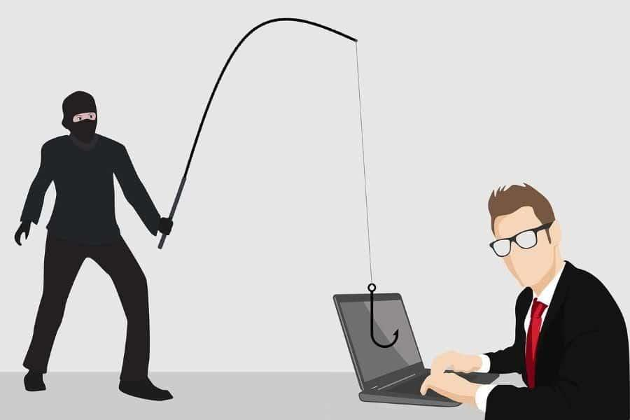
INTRODUCTION
Phishing is a type of social engineering where attackers use deceptive tactics to trick individuals into revealing sensitive information, such as passwords, credit card numbers, or bank account details.
These attacks often come in the form of emails, text messages, or phone calls that appear to be from legitimate sources like banks, online retailers, or government agencies.

Slide 4
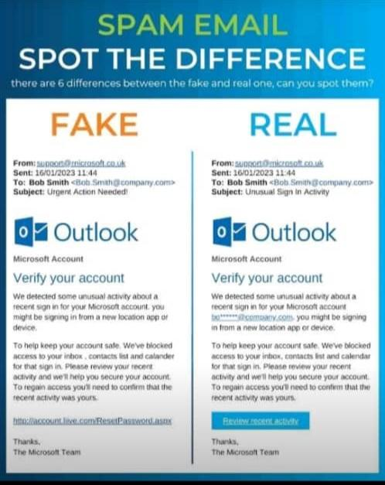

Slide 5

OBJECTIVES
Set up a phishing detection campaign using the Cowrie honeypot to capture phishing attempts and analyze data in Splunk.
PURPOSE
Enhance detection of phishing attacks, gather intelligence on attack patterns, and build defenses

Slide 6

MOTIVATION
Threat intelligence gathering by;
stimulating vulnerable SSH services.
Attracting malicious actors to gain a clear of emerging phishing trends and threats.
The use of honeypot as a defensive tool to counter malicious actors tactics and attacks.

Slide 7

Challenges we are trying to solve in real time
Understanding attack pattern
Testing security tool
Legal evidence collection
Mitigating attacks in advance
Contribution to the security community

Slide 8

Tools use
Cowrie
splunk
Why Use these tools?

Slide 9
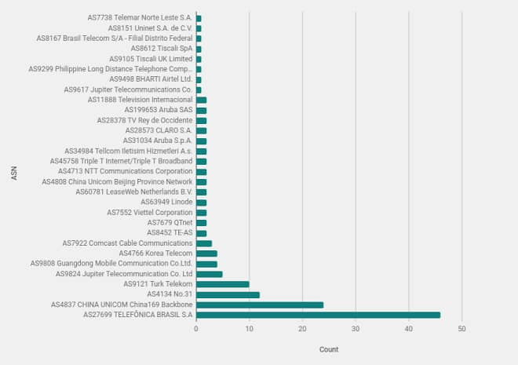
Data Flow Architecture

Slide 10
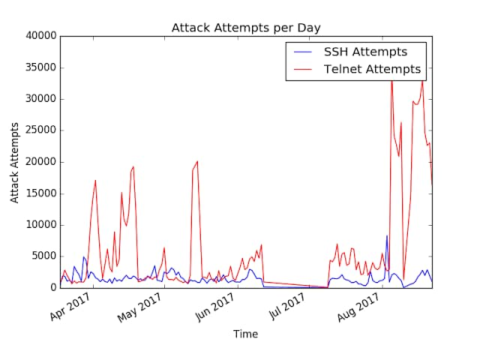
Data Flow Architecture

Slide 11
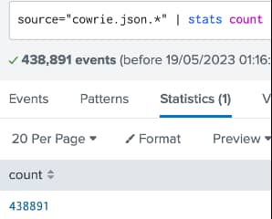
Data Flow Architecture

Slide 12
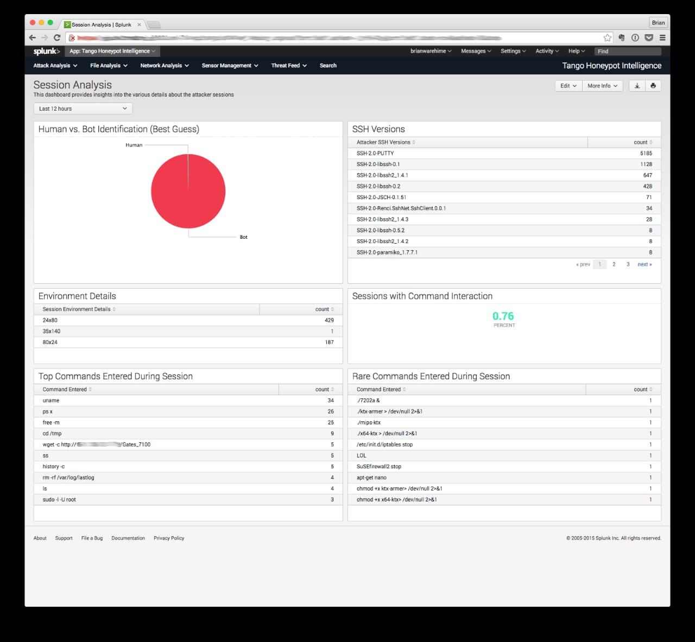
SESSION ANALYSIS

Slide 13
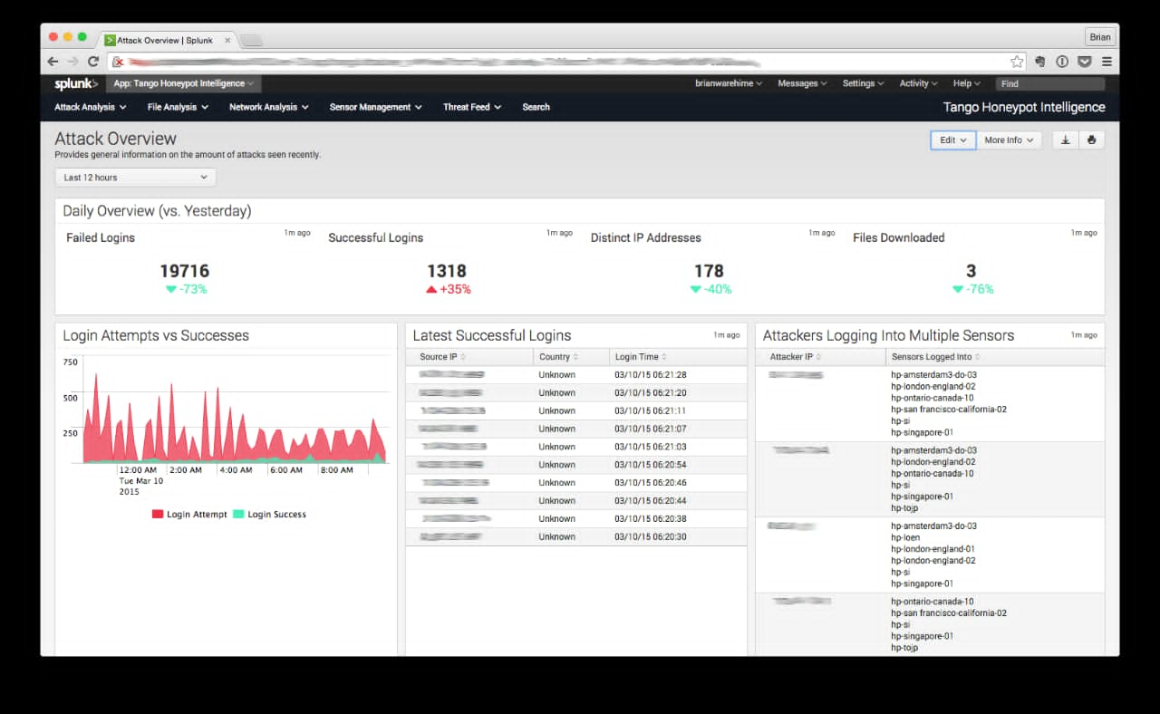
SESSION ANALYSIS

Slide 14
Expert recommendation
Regularly update and configure honeypot.
Combine honeypots with tools like cowrie to monitor network traffic.
Use cowrie detailed section logging especially for SSH base phishing and brute-force attempts.

Slide 15

Conclusion
The combination of tools provided us with security measure and educate users on how to spot and avoid phishing attempt and helped them improve overall network defence strategy.

Slide 16

Thank you

